Slide 1
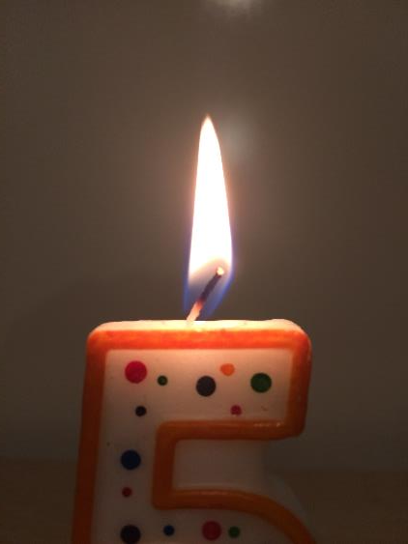
Chemistry Combustion
LabRat Scientific
© 2018

Slide 2
Some Useful Terms Related to Combustion
Exothermic: A process that releases energy – usually as heat, but also as light
Endothermic: A process that absorbs heat
Pyrolysis: The thermal decomposition of a material at elevated temperatures
Incomplete Combustion: When there is not enough oxygen to allow all of the fuel to react
Hydrocarbon: A compound composed of Hydrogen and Carbon (i.e. Methane CH₄)
Redox (Reduction – Oxidation): Reactions that involve the transfer of electrons between chemical species. Oxidation means the electron(s) are stripped away, and Reduction means electron(s) are added.
Incandescence: The emission of electromagnetic radiation (i.e. light) from a hot body

Slide 3
Combustion
Combustion is an exothermic redox chemical reaction.
Heat, light and other less useful biproducts (e.g. smoke, soot, carbon monoxide) are generated during the combustion process.
In some cases, heat needs to be introduced to the system to get the reaction started.
In some cases, the reaction can be “spontaneous” where self-heating can occur.

Slide 4
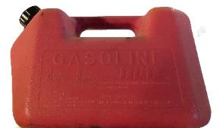
Combustion
There are three things are needed for combustion to occur:
8
O
15.9994
Oxygen
Fuel
Oxygen
Heat
If any one of these is absent, the combustion process will not start or will cease if already underway…

Slide 5
Combustion
In the case of a match, a candle, or a campfire, an initial source of heat is needed to get the reaction started.
Striking the match creates friction that results in heat that ignites the combustible material on the match head.
The match can then be used to introduce heat to a candle wick.
The candle can then be used to introduce heat to the kindling under a stack of campfire wood.

Slide 6
Fuel Sources
Fuels come in various states:
Solid (wood, coal, rubber, etc.)
Liquid (gasoline, oil, alcohol, kerosene, etc.)
Gaseous (hydrogen, propane, methane, etc.)

Slide 7
Combustion Phases
Solid Fuel:
Preheating Phase – unburned fuel is heated to the flash point and production of flammable gas begins.
Gaseous Phase – when flammable gasses and oxygen ignite and burn.
Charcoal Phase – towards the end of the combustion process when the production of flammable gasses is too low to maintain a flame.
Liquid Fuel:
When the temperature of the liquid reached its “flash point”, a flammable vapor is generated. It is this vapor that burns, not the liquid itself.

Slide 8
Combustion Phases
Gaseous Fuel:
Several types of combustion can occur – the type depends on the degree of mixing with the oxidizer and the pressure
Types
Diffusion – when fuel and oxidizer are initially separated and then slowly mix via the migration of molecules from an area of high concentration to an area of low concentration (diffusion). Diffusion is generally a slow process so the flame speed is relatively low.
Premix – when the fuel and oxidizer are intentionally mixed together before being ignited (a cutting torch is an example).
Detonation – Very rapid combustion. Flame front moves at supersonic velocities.

Slide 9
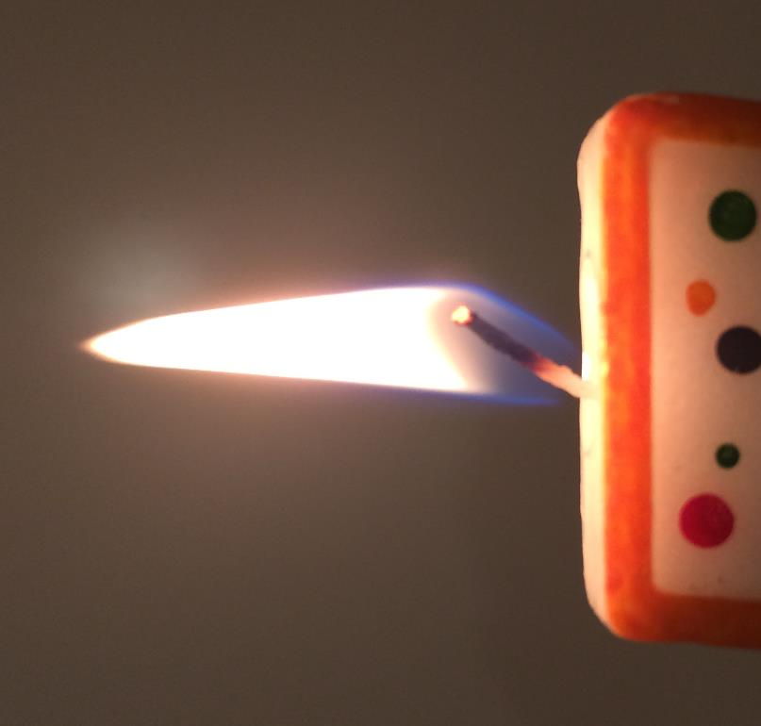
Mechanical Characteristics of a Candle Flame
Cooler “Yellow” Flame. Due to incandescence (glowing) of very fine soot particles.
The wick draws up melted wax. The flame vaporizes the wax creating a combustible gas.
Hotter “Blue” Flame. Due to less fine soot in this area.

Slide 10
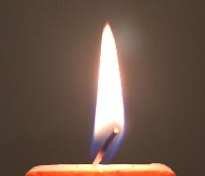
Dynamics of a Burning Surface
The initial heat source heats the surface.
O
O
The carbon in the gas reacts with oxygen in the air which generates more heat.
O
O
C
C
The heated surface liberates a combustible gas (endothermic pyrolysis).
C
C
C
C
C
C
C
C
C
C

Slide 11
Dynamics of a Burning Surface
O
O
O
O
O
The initial heat source can be removed, and the reaction becomes self heating…
Zone of Combustion
C
C
C
C
C
C
C
C
C
C
C
C
C
C
C
C
The actual combustion event takes place just above the surface of the combustible material…

Slide 12
Dynamics of a Burning Surface
O
O
O
O
O
O
O
C
Zone of Combustion
C
C
C
C
C
C
C
C
C
C
C
C
C
C
C
C
The heated area expands, releasing more combustible gas and the flame spreads…

Slide 13
The Chemistry of Combustion
Combustion (burning) is a chemical reaction. This reaction can be represented by a chemical equation.
If Carbon (C) is combined with Oxygen (O) and heat is added, combustion will occur.
The equation: C + O₂ → CO₂
The “+” means “reacts with” and the “→” means “produces”
The equation above says that Carbon (i.e. coal) “reacts” with Oxygen during combustion to “produce” Carbon Dioxide

Slide 14
The Chemistry of Combustion
Combustion of Methane CH₄:
Since CH₄ is composed of purely Carbon and Hydrogen, it is known as a Hydrocarbon.
By definition, the products of the chemical reaction are going to be CO₂ and H₂O
CH₄ → CO₂ + H₂O
Oxygen is needed on the left-hand side
CH₄ + O₂ → CO₂ + H₂O (recall than the oxygen is the oxygen molecule, O₂)
The equation can be balanced to determine how much CO₂ and H₂O is produced
CH₄ + 2O₂ → CO₂ + 2H₂O (the number of C’s, O’s, and H’s are the same on both sides)

Slide 15
Burning of Elements
Carbon: Yields Carbon Dioxide
Sulfur: Yields Sulfur Dioxide
Iron: Yields Iron Dioxide
Notice that since the reaction in question is combustion, the product is a “dioxide” which is two Oxygen atoms attached to the elemental atoms.

Slide 16
Questions?

